Slide 1

Recommender System Study Case
Débora Santos - 20200748 Pedro Medeiros - 20200742 Rebeca Pinheiro - 20201096

Slide 2
BACKGROUND
BUSINESS GOAL
Implement a recommender system.
Cold star problem: offer relevant products to new customers.
ManyGiftsUK

Slide 3
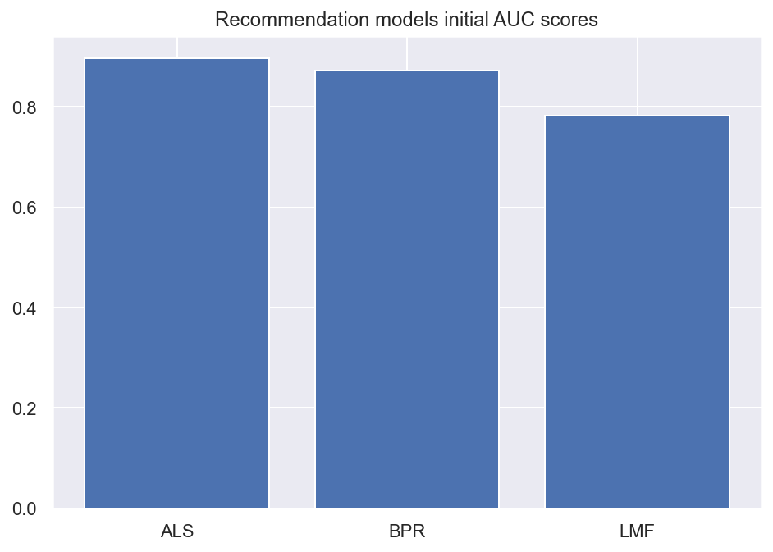
KEY FINDINGS
Algorithm
AlternatingLeastSquares

Slide 4
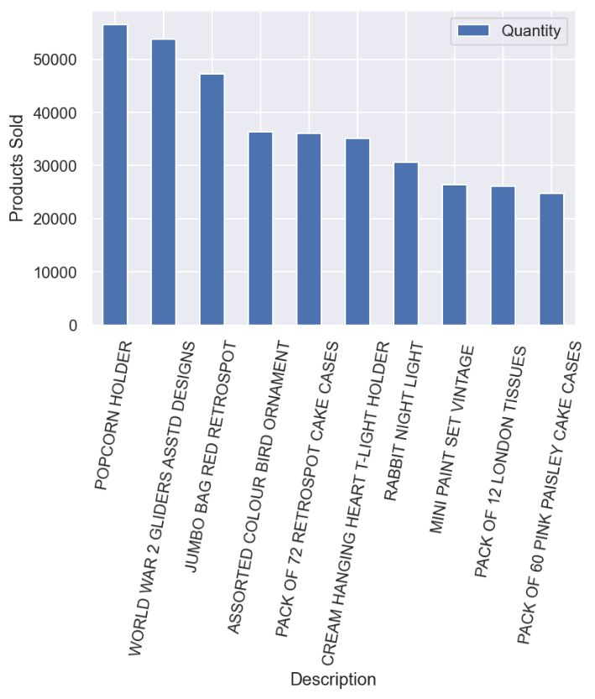
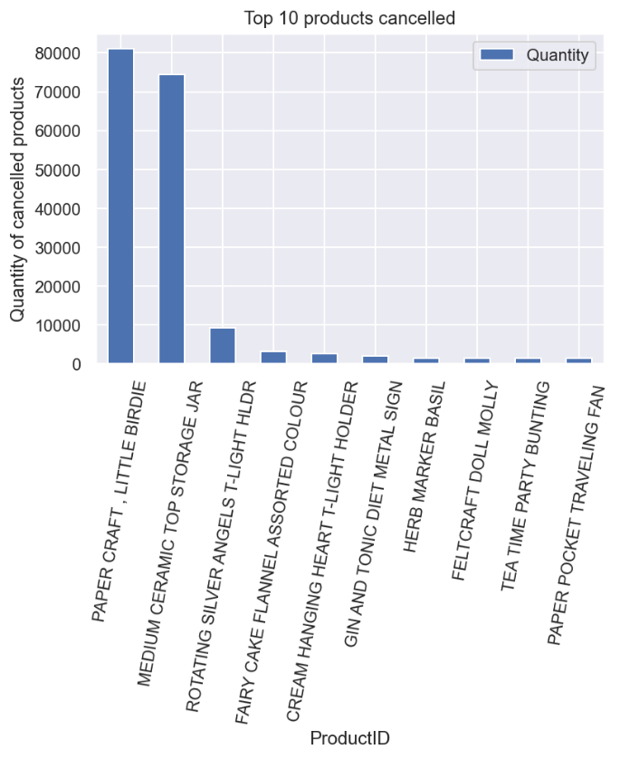
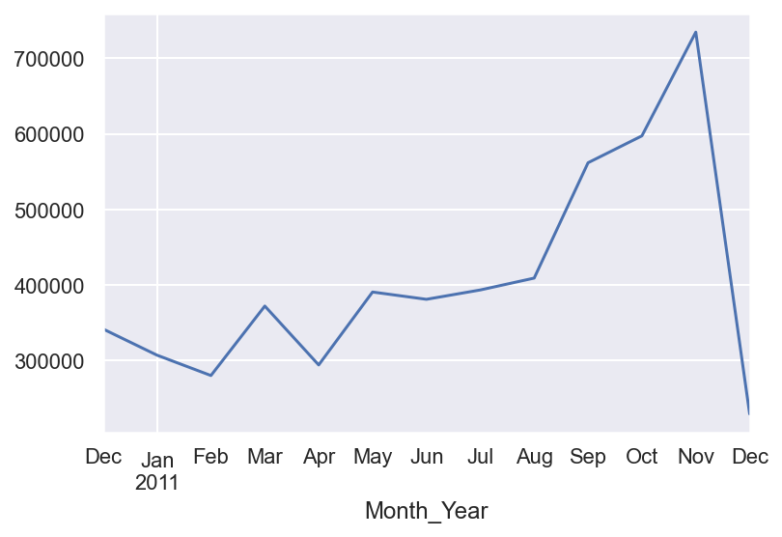
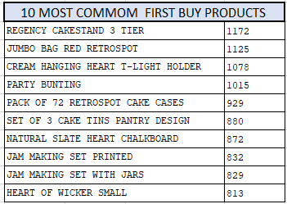
KEY FINDINGS
PRODUCTS ANALYSIS
The most common selling product is Popcorn Holder, followed by World War 2 Gliders Asstd Designs
In the first purchase, the most common selling product is 22423
The most cancel item is Paper Craft, Little Brigde followed by Medium Ceramic Top Storage Jar
CONSUMER BEHAVIOURS
The period is most selling is from September-November
In the first purchase, the most common selling product is Regency Cakestand 3 Tier

Slide 5
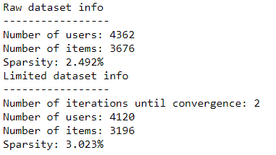
PROJECT PLAN
Data Preparation: Remove duplicates observations, eliminate StockCode itens which didn’t fit the proposed format, remove itens which price were equal 0 (2% removed of total data).
Feature Engineering: Two new variables created:
For missing CustomerID there were created a fake customer id number, according the invoice number.
Modelling: Split data into train and test dataset
Reduce sparcity
Removed items with quantity = 0
Create Itens Matrix and User Matrix
HyperParameter tunning
New variables | Description
Month_Year | Month and Year related to that transaction.
Total_Value | Value of the transaction, calculated by multiplying the unit price and quantity

Slide 6
PROJECT PLAN

Slide 7
KEY TAKEAWAYS

Slide 8
Fully Editable Icon Sets: A

Slide 9
Fully Editable Icon Sets: B

Slide 10
Fully Editable Icon Sets: C

